Slide 1
Agile Development Tutorial Group 2 Role: Manufacturer

Slide 2
Group members
Chan Chi Lap Toby 54777615
Kwok Ching Yin Mark 54777770
Lo Ho Tin Jeffrey 54777719
Wong Yan Tin Ivan 54777688
Wong Kwun Hoi 54787805

Slide 3
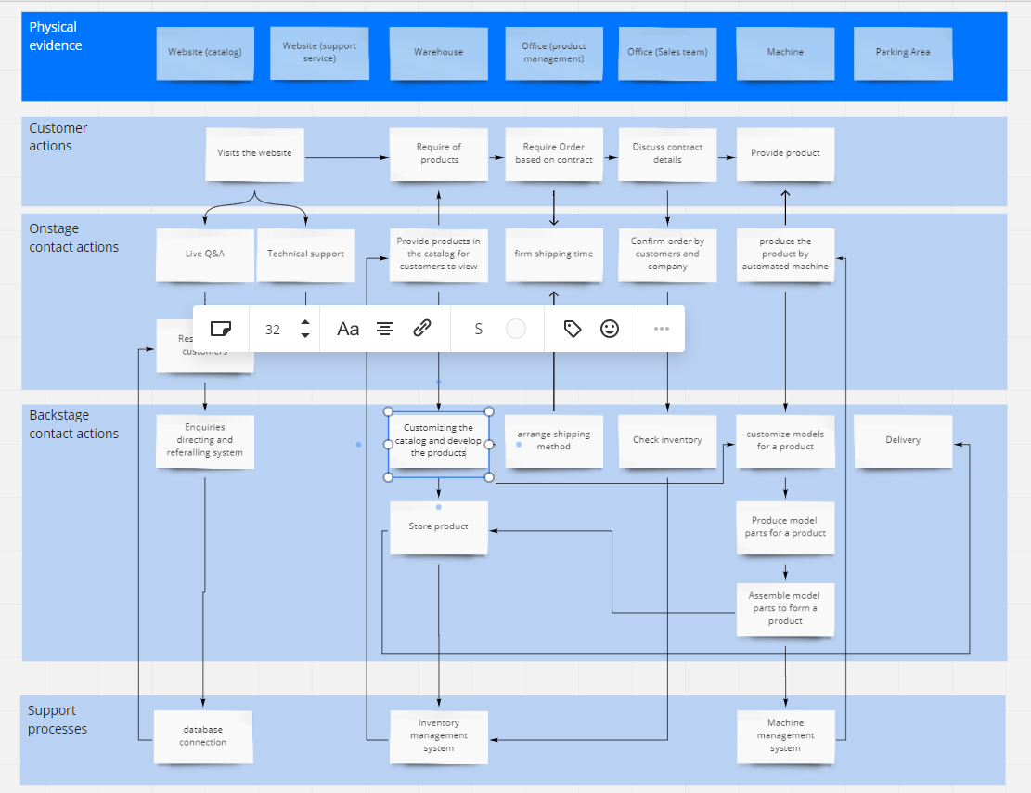
Overview of Service Blueprint

Slide 4
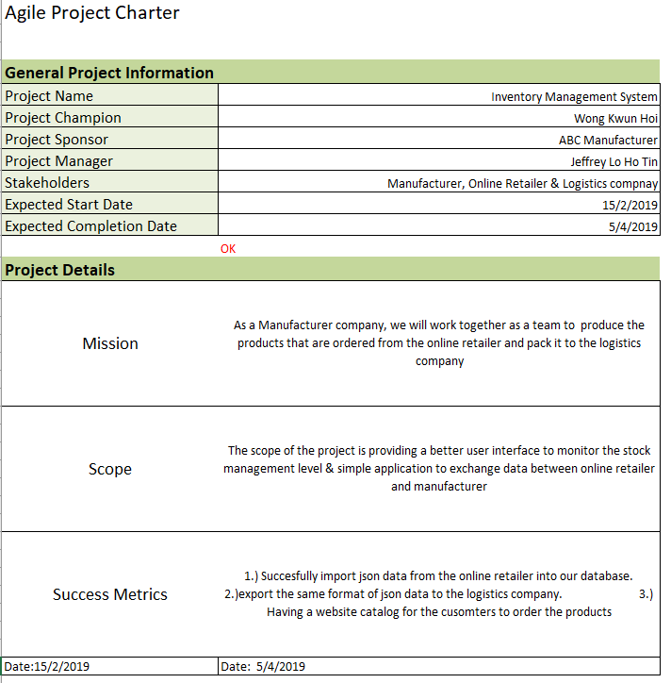
Agile Project Charter

Slide 5
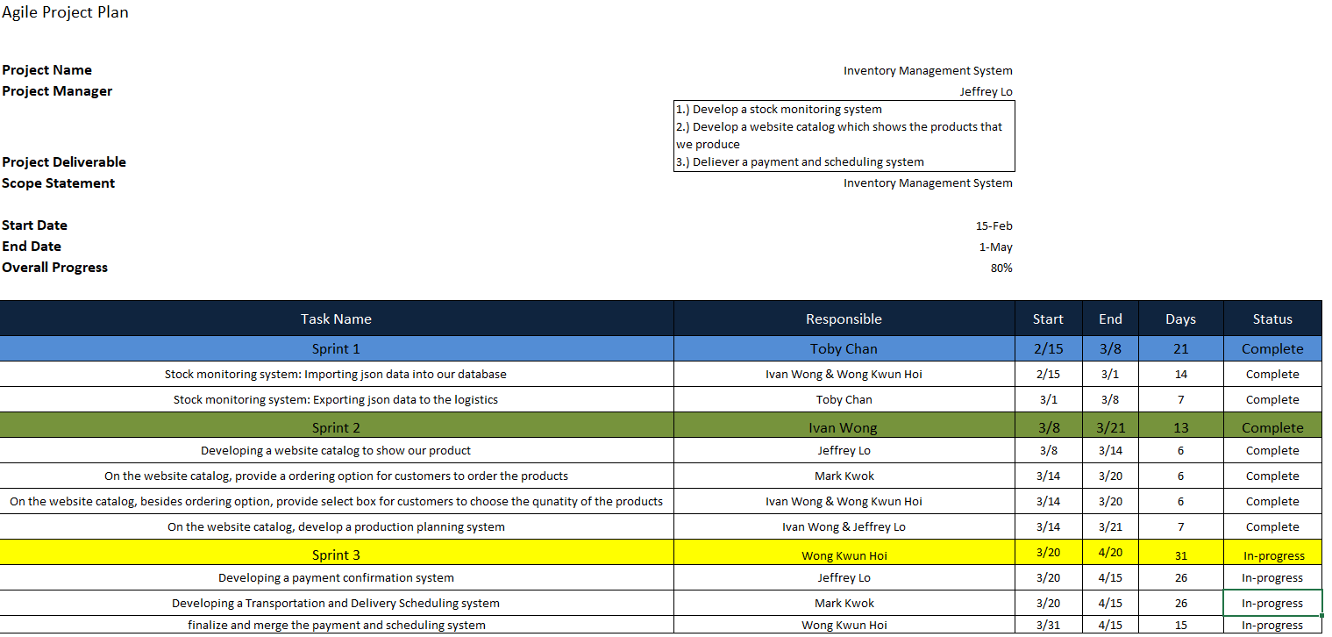
Agile Project Plan

Slide 6
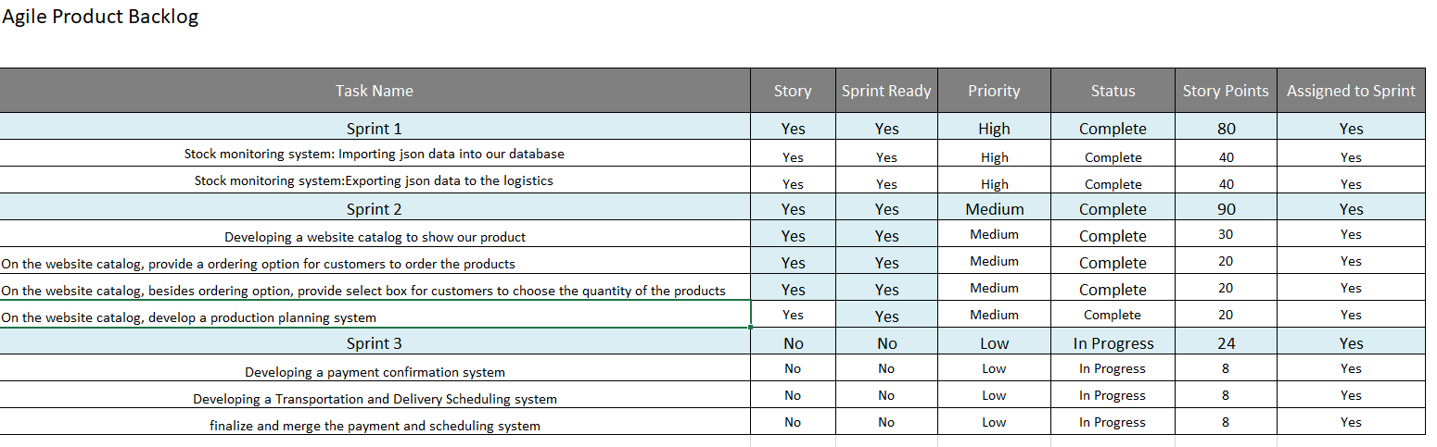
Agile Product Backlog

Slide 7
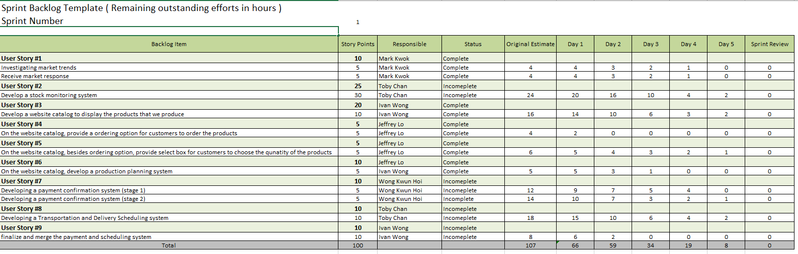
Agile Sprint Backlog

Slide 8
User stories

Slide 9
Agile Test Plan

Slide 10
Data interface layout data

Slide 11
Manufacturers to Logistics
order_no | Char(10)
retailer_id | Char(10)
logistics_id | Char(10)
Ship_date | datetime()
weight | Double(7,2)

Slide 12
Retailers to Manufacturers
item_no | char(10)
qty | int(10)
price_per_item | double(7.2)
retailer_id | char(10)
expected_shipment_date | datetime()
manufacturer_id | char(10)

Slide 13
Responsibilities between Manufacturer & Logistics
Provide order number to the logistics company
Calculate the total weight of the products
Provide ship date to the logistics company
Provide retail ID to determine the retail locations
Provide logistics ID to determine different logistics company

Slide 14

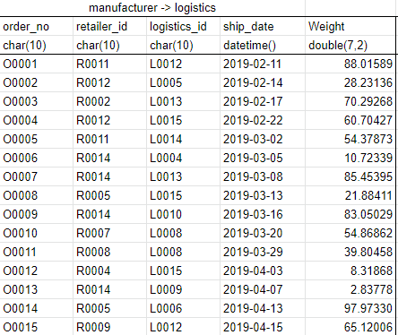
Manufacturer to Logistics Sample Data

Slide 15
Responsibilities between Retailer to Manufacturer
Receiving order from retailer
Assemble the products
Manufacture the products before the retailers expected date

Slide 16

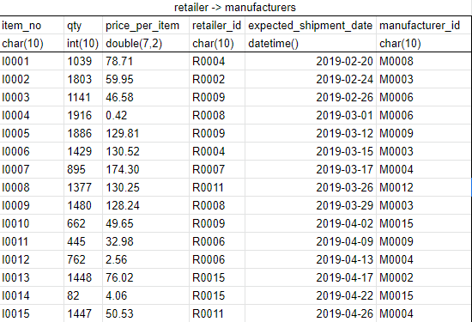

Retailer to Manufacturer Sample Data

Slide 17
End of Presentation

